Slide 1
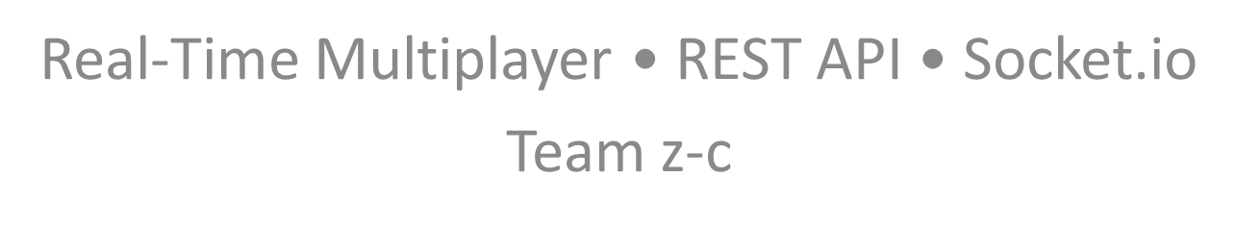
UNO

Slide 2
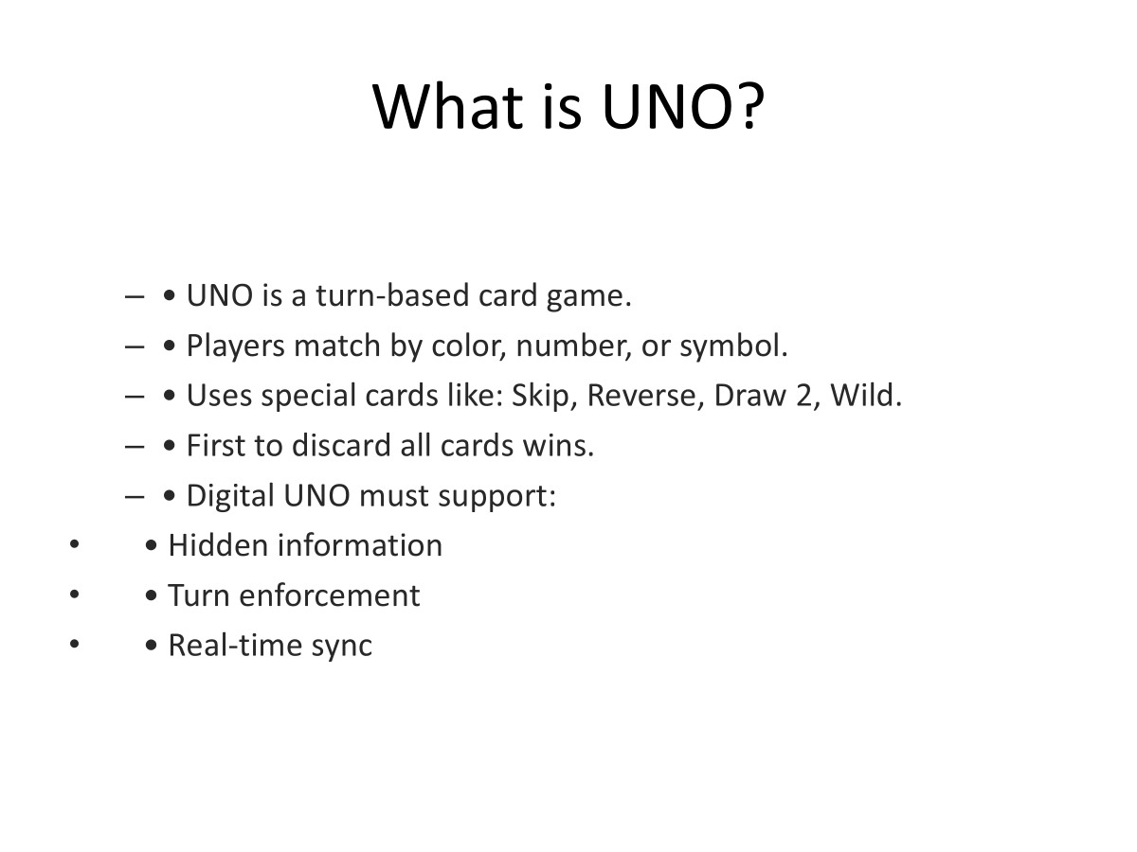

Slide 3
All API Endpoints (Overview)
Game Management Endpoints:
- POST /api/lobbies – Create Lobby
- POST /api/lobbies/:lobby_id/join – Join Lobby
- POST /api/games/:game_id/start – Start Game
- GET /api/games/:game_id – Get Game State
Game Action Endpoints:
- POST /api/games/:game_id/cards/:card_id/play – Play Card
- POST /api/games/:game_id/draw – Draw Card
- POST /api/games/:game_id/end-turn – End Turn
- POST /api/games/:game_id/chat – Send Chat Message

Slide 4
Deep Dive #1 — Draw Card Endpoint
Endpoint: POST /api/games/:game_id/draw
Validations:
- Game exists
- Player in game
- Player's turn
- Draw pile has cards
Edge Cases:
- Empty draw pile → reshuffle
- Player has playable card but tries to draw
- Lag double-draw
State Updates:
- Move top card to player's hand
- Advance turn
Socket.io Events:
- game:card:drawn (private)
- game:hand:update (private)
- game:turn:changed (public)

Slide 5
Deep Dive #2 — Play Card Endpoint
Endpoint: POST /api/games/:game_id/cards/:card_id/play
Validations:
- Player owns card
- Card matches color/number/type
- Wild must include chosen color
- Special card rules
- Must be player's turn
Edge Cases:
- Illegal play attempt
- Wild played without color
- Direction changes affecting next turn
State Updates:
- Add card to discard pile
- Apply effects (Reverse/Skip/Draw2/Draw4)
- Advance turn
Socket.io Events:
- game:card:played (public)
- game:state:update (public)
- game:hand:update (private)
- game:turn:changed (public)

Slide 6
Socket.io Events Summary
Public Events:
- game:state:update — broadcast on state change
- game:card:played — broadcast when card is played
Private Events:
- game:hand:update — hand changes
- game:card:drawn — drawn card sent privately

Slide 7
Public vs Private Game State
Public State:
- Current turn
- Top discard card
- Player card counts
- Game direction
- Game phase
Private State:
- Player hand
- Drawn card
- Wild chosen color
- Any hidden info

Slide 8
Architecture Pattern
1. Client sends POST action
2. Server validates request
3. Server updates database
4. Server returns 202 Accepted
5. Server broadcasts Socket.io events

Slide 9
Security & Anti-Cheat Validation
Server validates ALL actions:
- Never trust client
- Recalculate legal moves server-side
- Prevents players editing their own hands
- Prevents illegal draws/plays
- Ensures fairness across clients

